Slide 1
The Governor’s
Broadband Development
Office of
Kathy Johnson
Executive Director
Notes:
1

Slide 2
Mission
3. Increase Broadband Utilization
2. Increase Broadband Adoption
Office of Broadband Development
1. Increase Broadband Availability
Notes:
2

Slide 3
What is Broadband? Good question!!
FCC Definition before NBP 768 Kbps down | 200 Kbps up
<2010
2010
National Broadband Plan (NBP)
4 Mbps | 1 Mbps
2015
Broadband Progress Report 25 Mbps down | 3 Mbps up

Slide 4
Alabama Definition of Broadband (2005)…

Slide 5
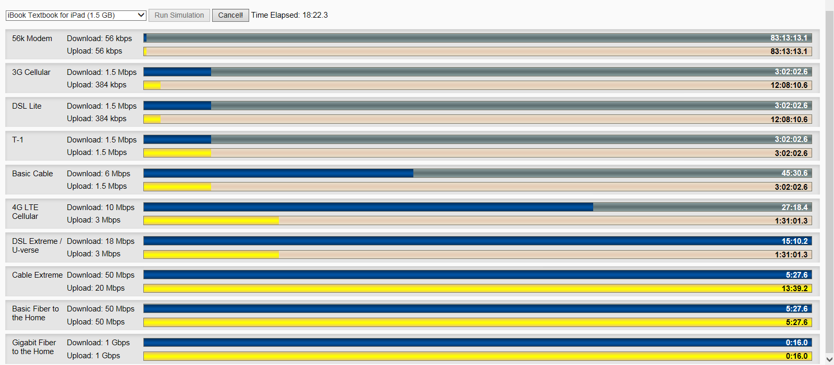
Does Speed Really Matter?

Slide 6
Based on 2015 data…

Slide 7
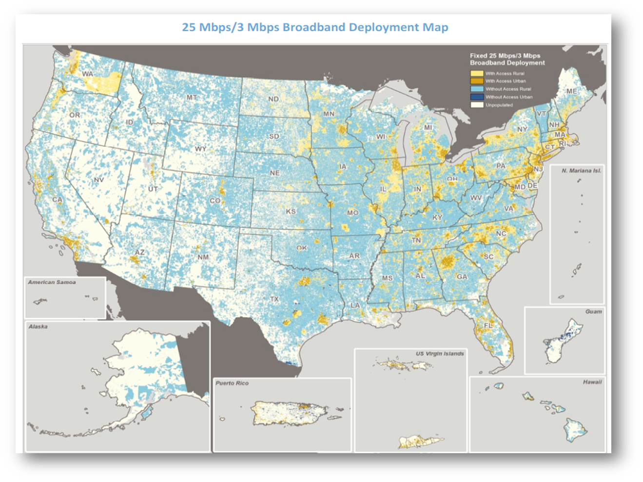
Where is Broadband? The “Haves” and the “Have Nots.”

Slide 8
But it’s improving…right?

Slide 9
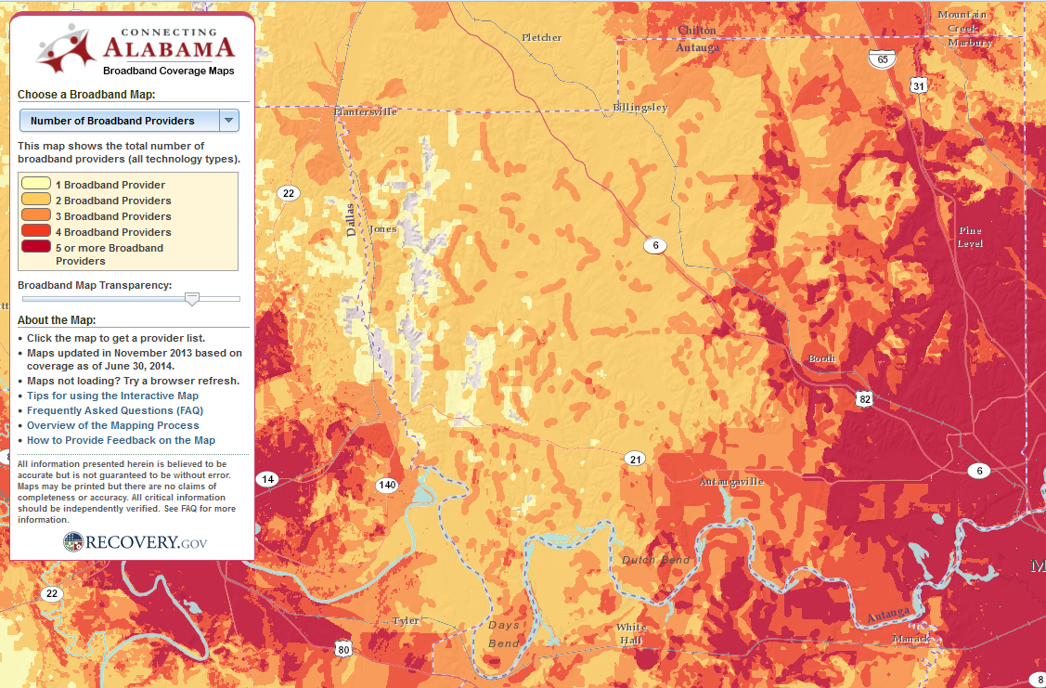
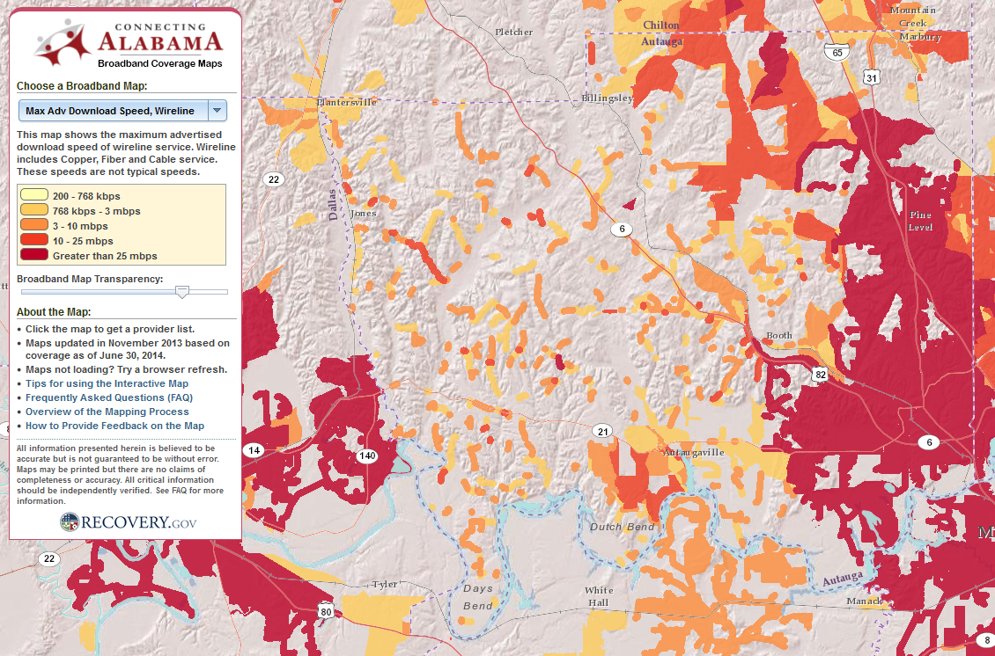
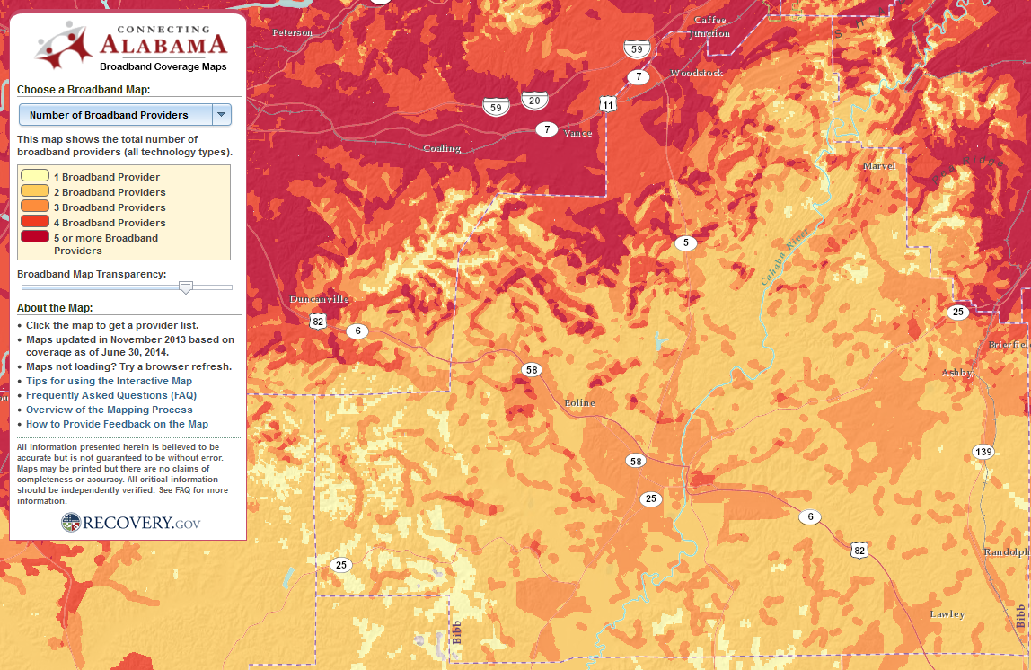
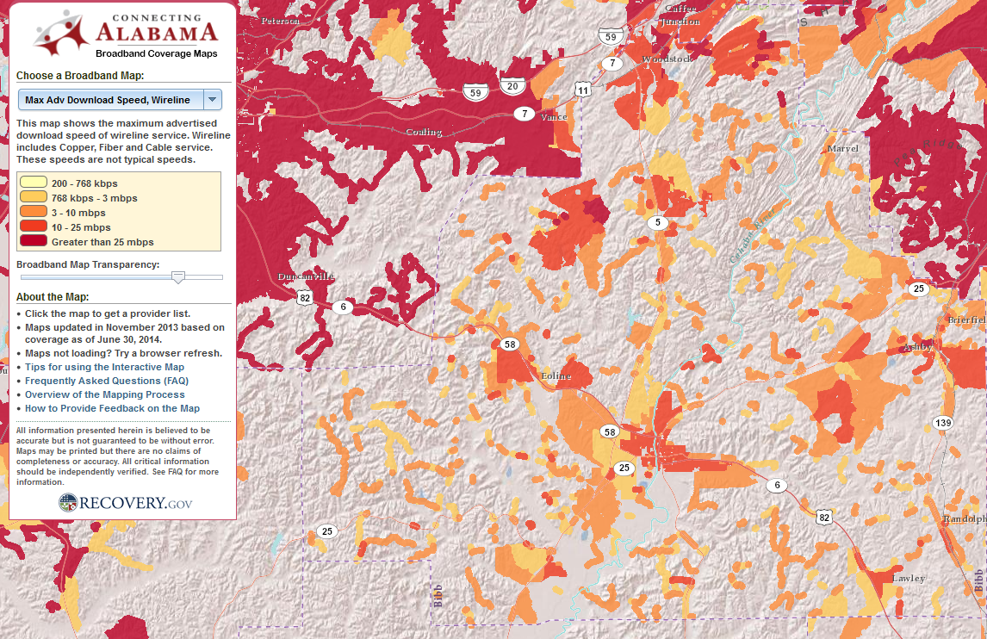
Autauga County
Bibb County

Slide 10
Why does it Matter?
Economic Development
Healthcare
Education
Public Safety
Conservation & State Parks
Agriculture
Telecommuting
Government Efficiency
Seniors and Disabled Populations
Tourism
Quality of life

Slide 13
Strategies & Tactics for H.O.P.E. through Broadband
5. Identify state, federal and other funding opportunities
4. Collaborate with state agencies & other stakeholders
Office of Broadband Development
3. Assess and recommend policies & initiatives
2. Collect & analyze data
1. Promote and facilitate partnerships
Notes:
13

Slide 14
The “Have Nots” (and some ISPs)

Slide 15
Access to Rights-of-Way: City, County, State and Rail

Slide 16
Statutes: Rights-of-Way
No provisions for compensation for counties from wired telecom providers.
Counties can require franchise or lease agreements for wireless access to ROW.
Local Government Services

Slide 17
Statutes: Municipal Broadband
Municipalities can construct/own/operate a broadband network (with limitations).
Rural electric cooperatives can construct/own/operate a network (with limitations).
Alabama Code does not have provisions for a county to construct/own a network.

Slide 18
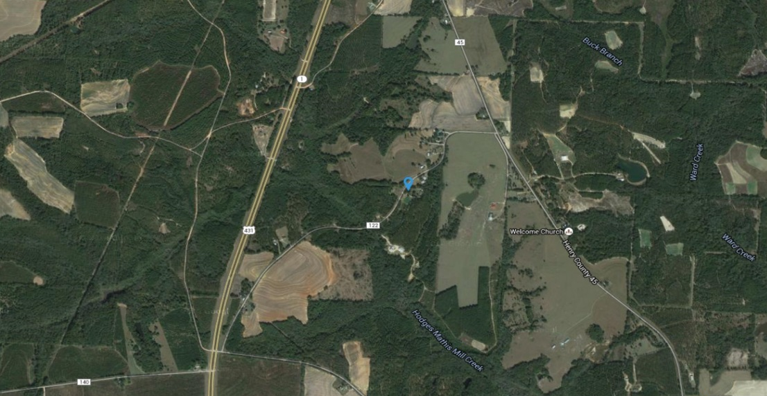
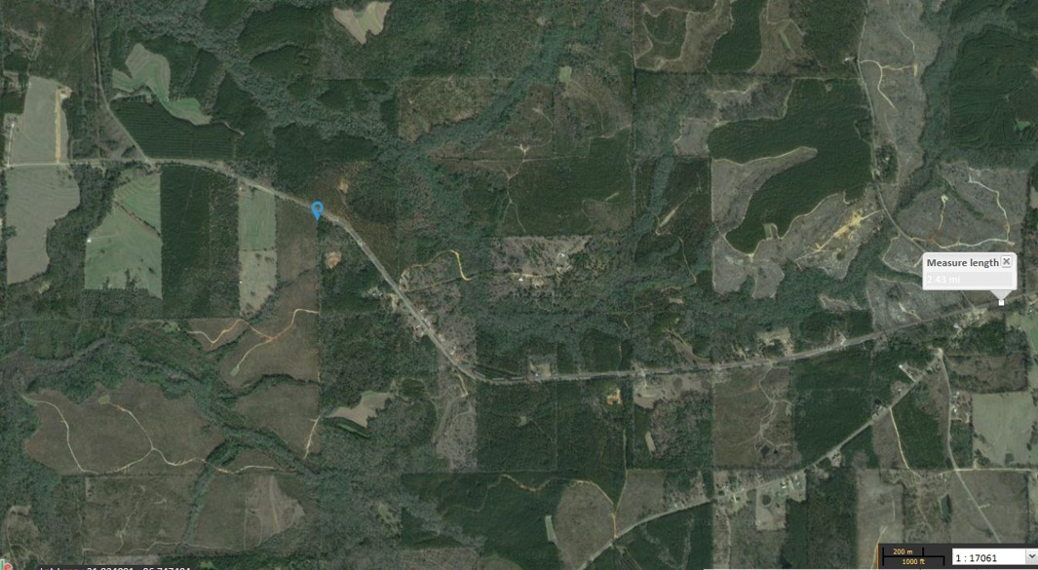
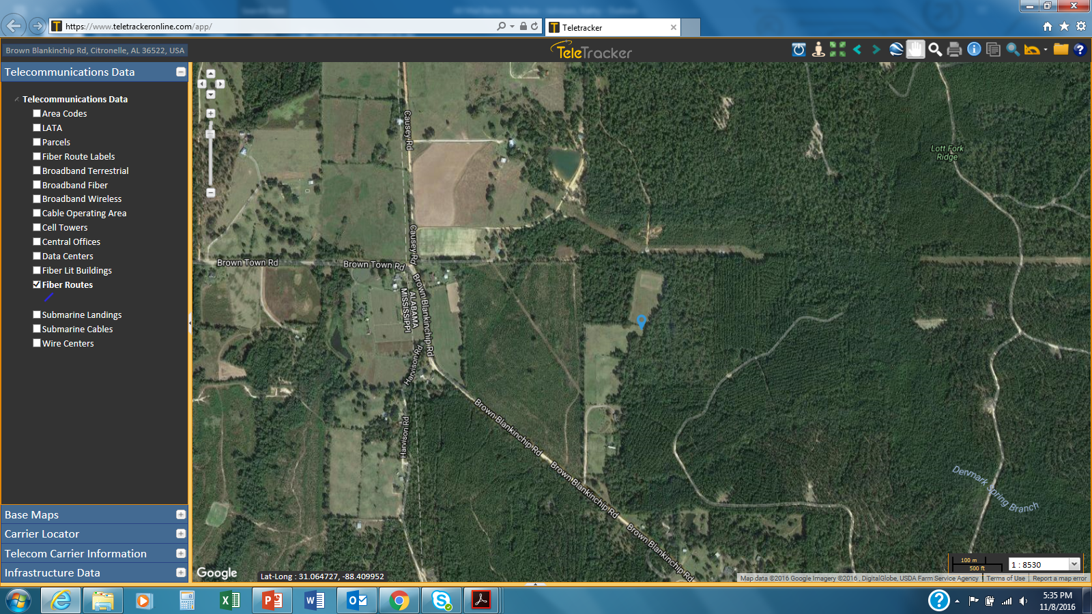
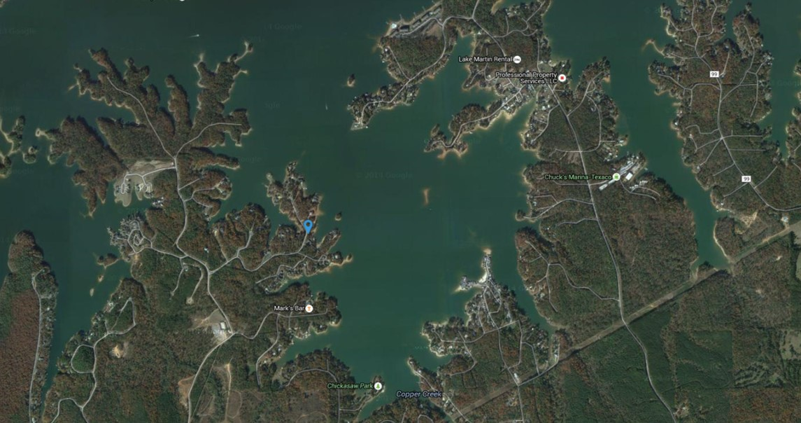
Headland
Selma
Citronelle
Lake Martin

Slide 19
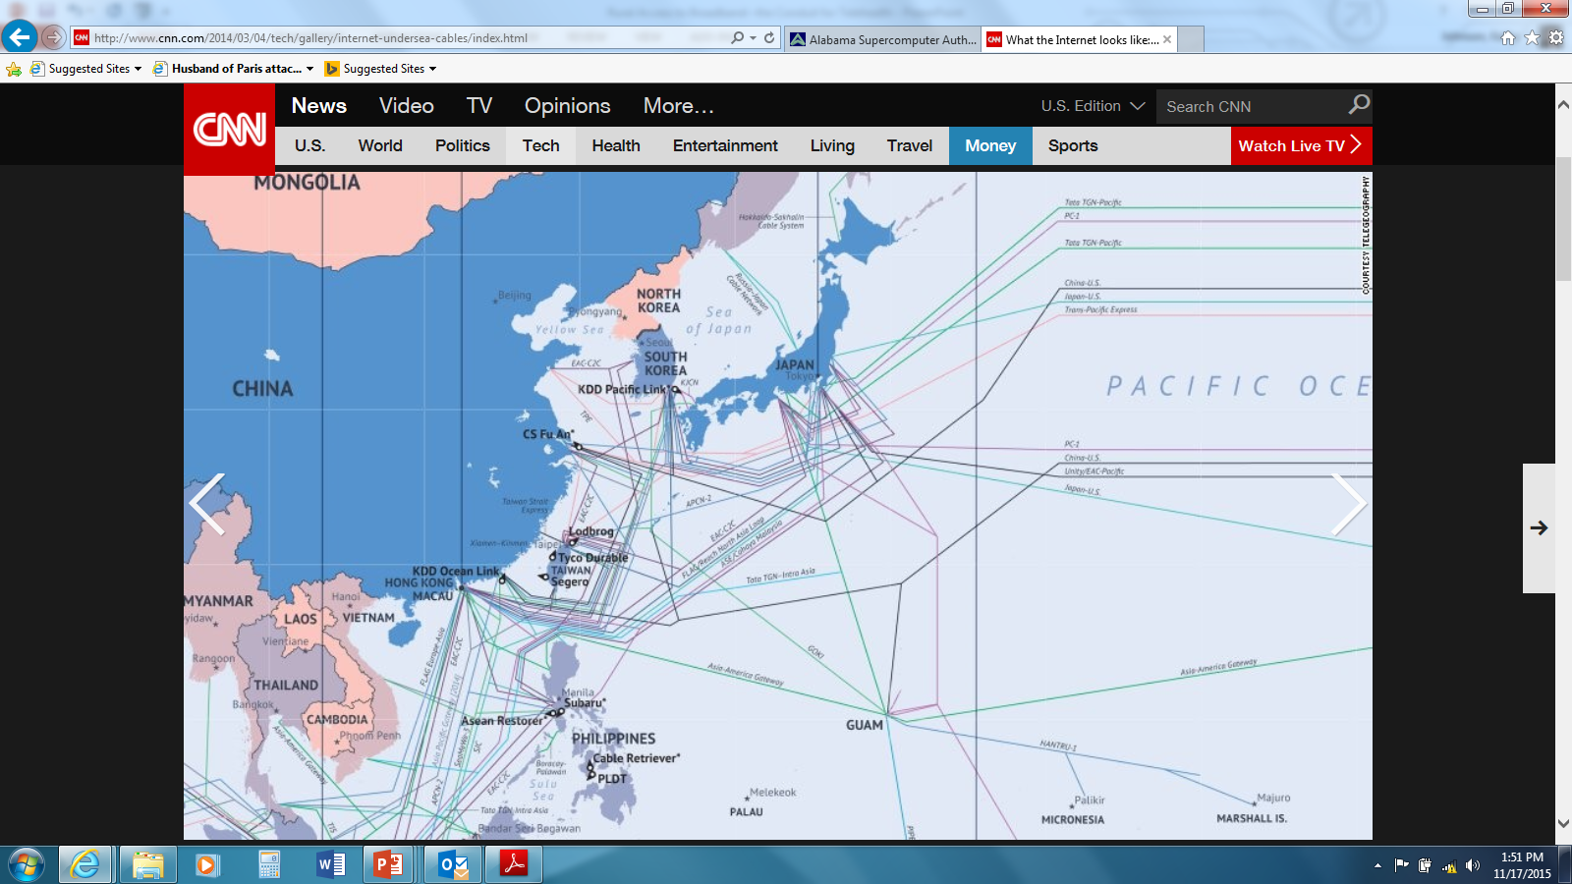

Slide 20
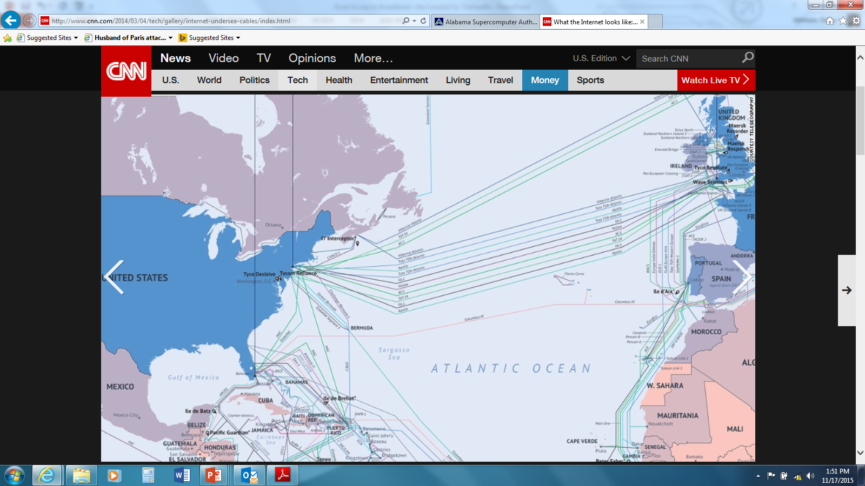

Slide 21
Questions?

Slide 22
Kathy Johnson
Executive Director
Office of Broadband Development
kathy.Johnson@obd.alabama.gov
334-353-2925

