Slide 1
Creating a “Go-To” Notebook for Your New Commissioners
Morgan Arrington, ACCA General Counsel

Slide 2
“Almost everyone will make a good first impression, but only a few will make a good lasting impression.”
- Sonya Parker
www.alabamacounties.org

Slide 3
New Commissioner’s Notebook
County Commissioner
Responsibilities/duties
This should be very brief bullet sheet of main areas of concentration
Chairman role
How are chair and vice-chair selected
Include any local policy/laws/court orders addressing chairman role
Compensation and Benefits
Salary and how/when paid
RSA info if in retirement system
Health insurance coverage –who pays
Travel reimbursement rules
County vehicle usage
www.alabamacounties.org

Slide 4
New Commissioner’s Notebook
County Government Organizational Chart
This should include each office that falls under the umbrella of county commission
Should also include offices of tax officials, sheriff, probate judge, and any other offices funded by county commission
May want separate charts for these offices
Pro Tip: A graphic representation that clearly shows the chain of command would be helpful for most new commissioners
www.alabamacounties.org

Slide 5
New Commissioner’s Notebook
County Information
County Map or information relating to accessing map
Copy of resolution or local law establishing district or unit system in county
May want to include something about funding district system offices
Demographics of county
Paved v. unpaved roads
Road miles
Population split for each district
Other
Pro Tip: Include a few pages about your county’s history and include “fun facts” or county trivia
www.alabamacounties.org

Slide 6
New Commissioner’s Notebook
Overview of the Other County Offices
Explanation of county funding obligations
How they interact with the Commission
Which employees fall under county commission personnel policies
Include contact information
Pro Tip: Include a list of entities for whom the Commission must provide office space and a list of those entities for whom the Commission voluntarily provides office space
Pro Tip: Include a list of agencies for whom the county serves as the payroll processor
www.alabamacounties.org

Slide 7
New Commissioner’s Notebook
County Attorney
Role of county attorney
“Rules” for contacting, etc.
Pro Tip: Include copies of any current court orders or consent decrees
www.alabamacounties.org

Slide 8
New Commissioner’s Notebook
Personnel Matters
County Employee Handbook/Personnel Policy
Relationship of employees working for other county officials (sheriff, tax officials, probate judge)
Role of County Commission in hiring/firing
New Employee Orientation package
Pro Tip: Include a copy of the employee pay plan
www.alabamacounties.org

Slide 9
New Commissioner’s Notebook
Local Boards/Commissions
Explanation of various local boards and commissions “created” by county commission or by statute
Include appointment process for each
Role, if any, of county commission in operation of board
Any county funding/appropriation
Pro Tip: Include a current listing of appointments including term expirations
www.alabamacounties.org

Slide 10
New Commissioner’s Notebook
Local Laws
Compilation of any local laws of particular importance
This should be limited to local laws affecting how county commission operates or how it impacts role of administrator/engineer
Things such as a home rule law, planning and zoning authority, etc., district or unit system law, county commission makeup law
Pro Tip: Find your county’s local law through the electronic Local Laws Index by County found at http://lsa.state.al.us/LRS/local_laws.aspx
www.alabamacounties.org

Slide 11
New Commissioner’s Notebook
Revenue Sources
Explanation of federal/state/local revenue sources for county
Not detailed explanation of revenue sources but what does county get
Itemization of local revenue and distribution
Pro Tip: Include a reference to any restrictions on the uses of the various funds
www.alabamacounties.org

Slide 12
New Commissioner’s Notebook
County Commission Meeting Items
Organizational Session Requirements
Copy of Rules of Procedure
Agenda-setting process
Any local policies/resolutions affecting meetings
Pro Tip: Include a calendar displaying commission meetings and works sessions, as well as other key events such as spring clean ups
www.alabamacounties.org

Slide 13
New Commissioner’s Notebook
Association of County Commissions of Alabama
Description of Organization
Contact Information
Include something about NACO
Conference/Training information
Pro Tip: Provide ACCA staff email addresses and encourage new commissioners to “whitelist” those listed
www.alabamacounties.org

Slide 14
New Commissioner’s Notebook
Training
ALGTI requirement/information
County Government Education Institute
Other conferences and workshops
Pro Tip: Provide a list of current county employees participating in a CGEI certification program
www.alabamacounties.org

Slide 15
New Commissioner’s Notebook
Legislative Issues
Contact info on all legislators
Explanation of “local” local legislation process
How handled with local legislators (re: resolution/meeting, etc.)
Pro Tip: The ACCA mobile app “ACCA67” contains updated information on all members of the Alabama Legislature
www.alabamacounties.org

Slide 16
New Commissioner’s Notebook
Calendar of Events
County Commission Meeting Dates
Important Dates for commission action (levy of taxes/budget approval, etc.)
ACCA/NACo events
Legislative Session Days
Pro Tip: The ACCA calendar is distributed annually at either the Legislative Conference or Legislative District Meetings
www.alabamacounties.org

Slide 17
New Commissioner’s Notebook
Current Events
Summaries/Reports from department heads of top pending issues
Administrator
Engineer
EMA Director
County Attorney
These will be reports of pressing ongoing matters such as lawsuits, negotiations, major impending road project, etc.
Pro Tip: Include a listing of any pending legislative issues that the commission is working on with the local legislative delegation
www.alabamacounties.org

Slide 18
New Commissioner’s Notebook
Information on County Liability and Worker’s Comp Insurance
Who is carrier
Who is covered
Process for reporting claims
Pro Tip: Include copies of any specific safety or security policies that have been adopted pursuant to coverage recommendations
www.alabamacounties.org

Slide 19
New Commissioner’s Notebook
Important Contact Information
Key state agencies (Ethics Commission, ALDOT, DOR, Governor’s office, Examiners, other)
Include contact persons
Pro Tip: Make an electronic copy with hyperlinked email addresses available
www.alabamacounties.org

Slide 20
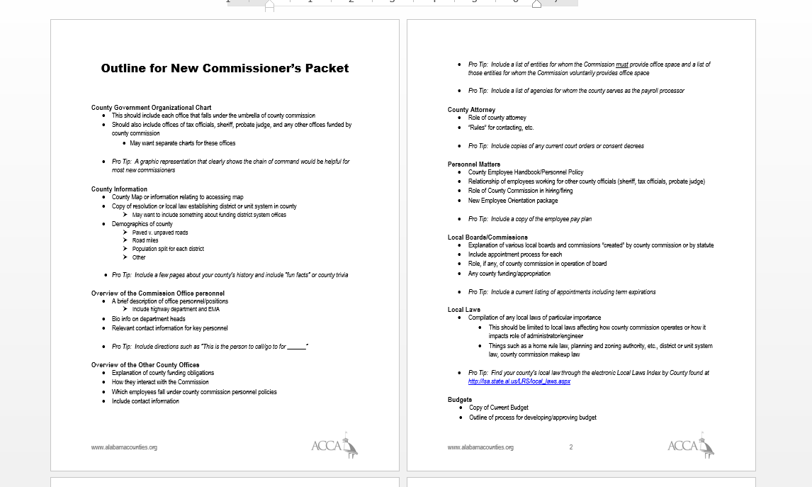
Template Available

Slide 21
Questions? More information?
Morgan Arrington, General Counsel
Association of County Commissions of Alabama
marrington@alabamacounties.org
(334) 263-7594

